Slide 1
VP160 Recitation Class 7
by Li Chunchao
2016/7/19

Slide 2
Short Review

Slide 3

Angular momentum
Angular momentum
Torque
Central force
Moment of inertia for a particle about a point
Conservation of angular momentum

Slide 4
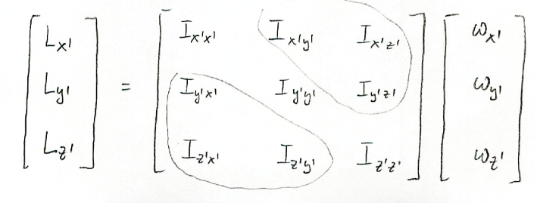
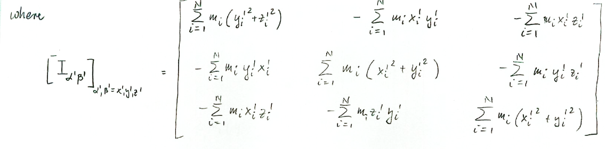
Rigid body
Definition
Tensor of inertia

Slide 5
Moments of inertia about a fixed axis
Some regular shape

Slide 6
Solving Problems

Slide 7
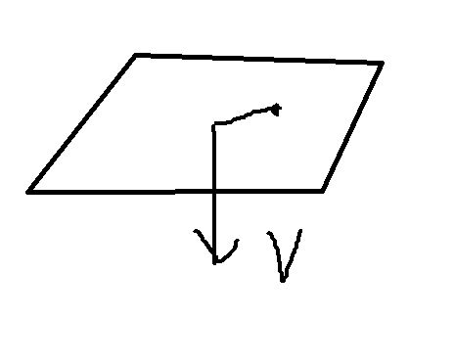
Angular momentum
A particle is dragged to the origin by a string. The decrease speed of the length of the string is v. The particle moving with initial speed v1. Its mass is m. Find the trajectory. The initial state is r=l0, 𝜑=0.

Slide 8
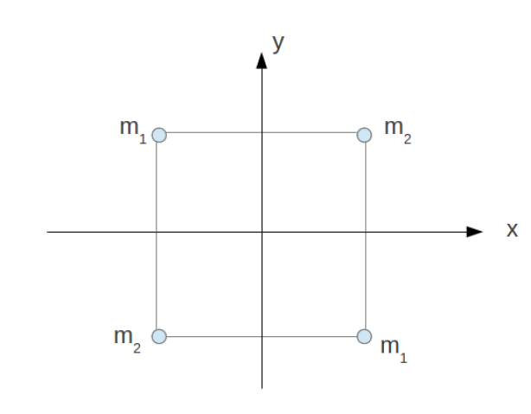
Angular momentum
A square with side length 2a, lies in plane z = 0 and has masses m1 and m2 in its vertices.
(a) Find the tensor of inertia
(b) Diagonalize this tensor (find principal moments of inertia and directions of the principal axes).

Slide 9
Moments of inertia about a fixed axis
Prove the moments of inertia about principal axis for cylinder

